Slide 1
Maintaining the EcoCyc
Metabolic Model
Wai Kit Ong
Pathway Tools Workshop 2018

Slide 2
Outline
FiveAM Test
Model Prediction Accuracy

Slide 3
EcoCyc Models
EcoCyc models available on biocyc.org
- cs-glucose-tea-none - cs-lactose-tea-none
- cs-glucose-tea-oxygen - cs-oleate-tea-nitrate
- cs-glycerol-3p-tea-fumarate - cs-tryptophan-tea-none
New version of EcoCyc released three times a year
Database curation
Software changes
Models checked after curation freeze during each release
Not obvious what broke the models
Limited time
cs: carbon source tea: terminal electron acceptor
Potentially break EcoCyc models

Slide 4
FiveAM Test Suite for EcoCyc Models
FiveAM is a regression testing framework
Ensures previously developed and tested software performs as expected
Rebuild software and run tests daily
Includes changes to database and software
Daily email with FBA comparison result summary
Benefits:
Detect problems immediately (daily)
Source of problem more easily identified
Save time

Slide 5
FBA Comparison Workflow
New pathway tools build
MetaFlux – Run FBA
Store results in an output file
Compare biomass with last good run ( )
If difference less than specified cutoff (1%), set new output file as “good” run
Else, generate comparison report
out
out
out
out
0
1
2
3
rep
Notes:
Mention what might cause a bad run
Cannot just compare every day with yesterdays

Slide 6
FBA Comparison Result Summary Email
Growth Condition | FBA-succeeded? | Comparison Status
cs-glucose-tea-none | T | NO-CHANGE
cs-glucose-tea-oxygen | T | NO-CHANGE
cs-glycerol-3p-tea-fumarate | T | NO-CHANGE
cs-lactose-tea-none | T | NO-CHANGE
cs-oleate-tea-nitrate | T | NO-CHANGE
cs-tryptophan-tea-none | T | NO-CHANGE
!!!
REPORT-GENERATED
REPORT-GENERATED
REPORT-GENERATED
REPORT-GENERATED
REPORT-GENERATED
REPORT-GENERATED

Slide 7
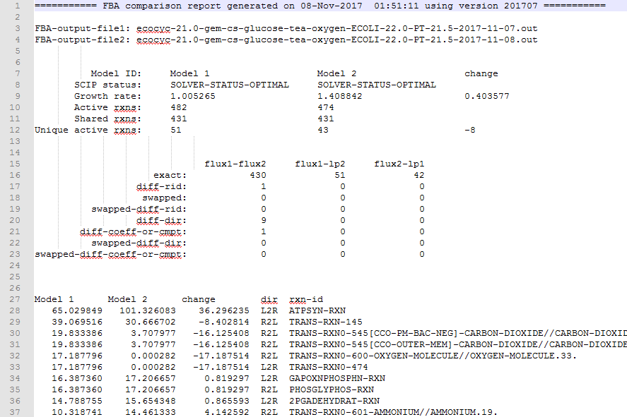
Check FBA Comparison Report File
rep
Source files
Basic model stats
Breakdown of types of differences
Actual reaction fluxes

Slide 8
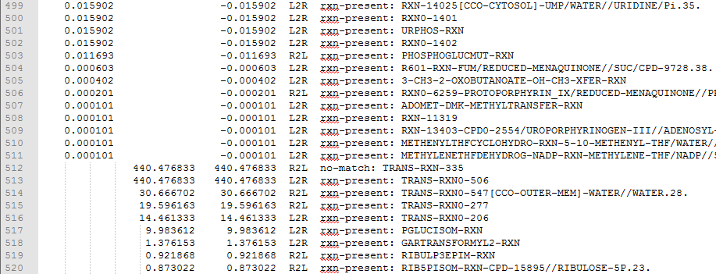
Check FBA Comparison Report File (cont.)
rep
Unique fluxes

Slide 9
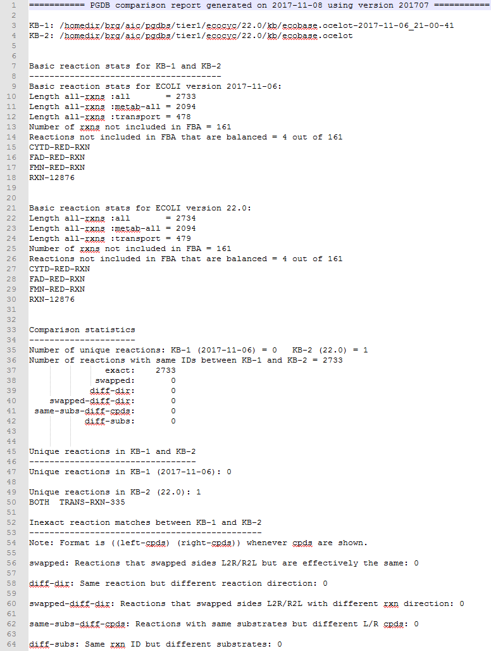
Check PGDB Comparison Report File
rep

Slide 10
Check FBA Solution File (.sol)
Flux: 440.476833456 (TRANS-RXN-335)
pyruvate[cytosol] + H+[cytosol] -> pyruvate[periplasm] + H+[periplasm]
Flux: 440.476833456 (TRANS-RXN0-506)
pyruvate[periplasm] -> pyruvate[cytosol]
Cycle between these reactions, pumping protons out of the cell
Action: Email curator with findings
Solution: TRANS-RXN0-506 to be deleted

Slide 11
PGDB Comparison Report File
Following day’s report shows that TRANS-RXN0-506 is removed

Slide 12
Model Prediction Accuracy
EcoCyc-18.0 – 95.2% | 1,445 single gene knockouts under glucose aerobic condition
EcoCyc-21.5⁺ – 91.0% | 1,650 single gene knockouts under glucose aerobic condition
iML1515 – 93.4% | 23,617 single gene knockouts across 16 carbon sources
Knockout Mutants Accuracy = (TP+TN)/(TP+TN+FP+FN) |  | Experimental Observation
 |  | Growth | No Growth
Computational Prediction | Growth | True Positive | False Positive
 | No Growth | False Negative | True Negative

Slide 13
Fixing False Predictions
Manual inspection/curation/literature search
b0003 (thrB) and b0004 (thrC) are essential genes in L-threonine biosynthesis pathway | False positives
RXN-15122 being reversible allowed an alternative route to L-threonine
Flux: 0.344684158 (RXN-15147) O-succinyl-L-homoserine -> succinate + (2Z)-2-aminobut-2-enoate + 2 H+
Flux: 0.344684158 (RXN-15122) (2Z)-2-aminobut-2-enoate + H2O + H+ -> L-threonine
Action: Email curator with findings
Solution: Fixed RXN-15122 reaction direction to be irreversible L2R

Slide 14
Fixing False Predictions (cont.)
Led to identifying unexpected bugs
b0072 (leuC) and b0071 (leuD) | false positives
RXN-13163
Genes associated with sub-reactions but not overall reaction

Slide 15
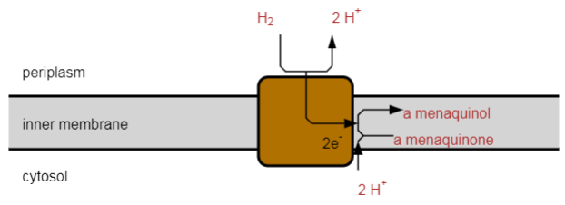
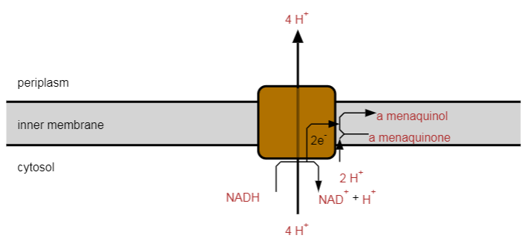
Unresolved Errors
RXN0-5256 (reversible)
RXN0-5388 (irreversible)
Trouble with cycle formed between these hydrogenase reactions
Consult iML1515 (2017) – Palsson Lab Ecoli Model
HYD2pp | Hydrogenase (menaquinol8: 2 protons) (periplasm) | Irreversible
Confidence score = 4; Reference = 1996
Ref: Pinske2015
Notes:
Confidence scores for each reaction
References for many reactions
Confidence 4 not reevaluated

Slide 16
Summary
FiveAM test for EcoCyc models helped speed up model fixing
Building a model can help improve its PGDB

Slide 17
Acknowledgements
SRI
Ingrid Keseler
Ron Caspi
Mario Latendresse
Peter Karp
External EcoCyc curator
Amanda Mackie
Funding sources:
NIH National Institute of General Medical Sciences

